Slide 1

Implementation of a Patient Management System (PMS) for Healthcare Organisation
A Comprehensive Approach to Enhancing Healthcare Operations
Presented By :

Slide 2

Introduction
Context: The healthcare organisation operates 50 clinics and a central hospital.
Objective: The goal is to implement a Patient Management System (PMS) that improves patient care, optimises administrative processes, and integrates seamlessly with the existing Electronic Health Record (EHR) system.
Presented By : Larana Corporate

Slide 3
Key Challenges
Fragmented Patient Data
Manual Processes
Limited Access to Records
Current systems are disconnected, leading to inefficiency.
Registration,appointment scheduling, and billing are currently handled manually, leading to human error.
Healthcare providers don’t always have real-time access to patient records, impacting care.
www.reallygreatsite.com
Presented By : Larana Corporate

Slide 4
Objectives of the PMS
Streamline Administrative Tasks
Centralise Medical Documents
Improve Patient Care
Optimise Billing and Payment
Simplify processes like patient registration, appointment scheduling, and billing.
Real-time access to comprehensive medical records.
Reduce manual errors and speed up the billing process.Reduce manual errors and speed up the billing process.
Secure and easy access to patient documents.
www.reallygreatsite.com
Presented By : Larana Corporate
Presented By : Larana Corporate

Slide 5

System Overview
Integrated System: The PMS will integrate with the existing EHR system, ensuring real-time data updates.
Core Features
Patient Registation
Appointment Scheduling
Billings And Payments
Documents Management

Slide 6

Key Features of the PMS
Simple and quick process for both online and in-person registration.
Patients can book, reschedule, or cancel appointments through the portal.
Automated generation of bills, payment processing through online gateways.
Secure storage and retrieval of medical records, prescriptions, and test results.

Slide 7

System Design and Architecture
Architecture Overview: A high-level overview of the system’s components and how they interact:
Patient Portal: Interface for patients to access appointments, bills, and medical records.
Admin Interface: For managing patient data, appointments, and billing.
Healthcare Provider Access: For doctors and staff to view patient records and manage treatments.
EHR Integration: Ensures seamless real-time data updates

Slide 8
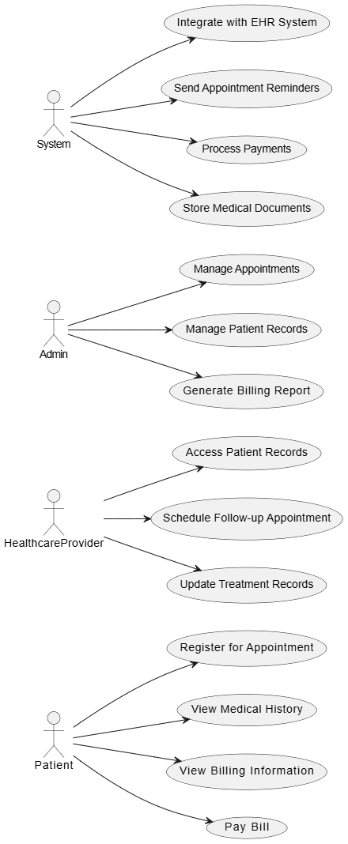
Use Case Diagram
www.reallygreatsite.com

Slide 9
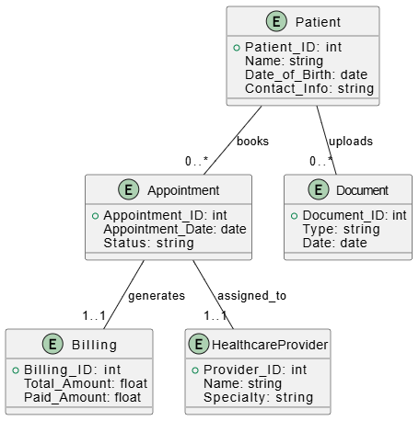
Entity Relation Diagram
www.reallygreatsite.com

Slide 10
System Interfaces
Patient Portal Interface
Healthcare Provider Dashboard
Provides patients with access to their medical history, appointments, and billing information.
Allows providers to access patient data, update treatment records, and manage appointments.
Admin Interface
Document Management Interface
:Admins can manage patient data, schedules, and billing information.
For uploading, accessing, and managing medical documents securely.
www.reallygreatsite.com
Presented By : Larana Corporate

Slide 11
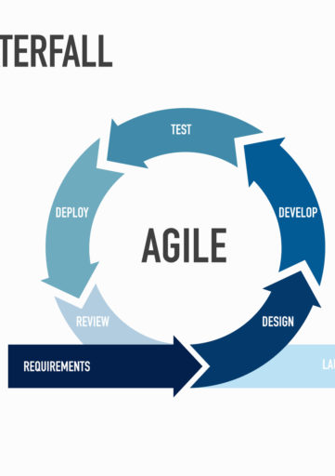

Development Strategy
Agile Methodology:
Stage 1: Planning and Requirements Gathering
Stage 2: Design and Prototyping
Stage 3: Development and Testing
Stage 4: Deployment and Monitoring
www.reallygreatsite.com
Presented By : Larana Corporate

Slide 12
Requirements gathering and system design
Full system deployment, starting with a pilot clinic.
Phase 1
Phase 3
Phased Implement-ation Approach
Phase 2
Build and test core functionality (e.g., patient registration, billing).
www.reallygreatsite.com
Presented By : Larana Corporate

Slide 13



Benefits to the Healthcare Organisation
Efficiency
Improved Care
Patient Satisfaction
Streamlining administrative tasks reduces time spent on manual processes.
Real-time access to patient data leads to better clinical decision-making.
Faster appointment scheduling and easier access to records improve the patient experience.

Slide 14



Benefits to Patients
Convenience
Engagement
Transparency
Access to appointment scheduling and billing online.
Patients will have more control over their healthcare, with real-time access to records.
Clear visibility of billing information and treatment history.

Slide 15

Challenges
System Integration: Integrating PMS with existing EHR systems.
Data Security: Ensuring patient data is protected.
Staff Training: Ensuring all users are proficient with the new system.
Presented By : Larana Corporate

Slide 16

Mitigations
Phased roll-out and comprehensive training.
Robust cybersecurity measures.
Continuous support for users.
Presented By : Larana Corporate

Slide 17

Conclusion
The PMS will improve operational efficiency, patient care, and overall satisfaction.
Integration with the existing EHR system ensures seamless data flow across clinics and the central hospital.
A phased Agile approach guarantees a flexible, efficient deployment.
Presented By : Larana Corporate

